Slide 1

The Covid-Weather-Connection Project
SAKSHI REDDY METHKUPALLY - 18XJ1A0549
VINUTHNA GHATTAMANENI - 18XJ1A0566
MAYANK DESHPANDE- 18XJ1A0529
OBJECT ORIENTED PROGRAMMING
Dr. Prafulla Kalapatapu

Slide 2
Problem Statement
SARS CoV - 2 is the coronavirus which is responsible for the 2020 global pandemic. Academic researchers, doctors and biochemical engineers are invested in solving this crisis. Previous cases of virus epidemics (eg. 2001 SARS, ebola) have suggested that weather factors could influence the spread of the virus. There is a possibility that COVID-19 falls in this category as well.
OBJECTIVE: To design an app in JAVA that through data visualisation allows us to see a possible connection between weather factors and the spread of the virus.

Slide 3
The following weather factors were chosen :
Temperature
Dew point
Heat index
Relative Humidity
Specific Humidity

Slide 4
TEAM MEMBERS' CONTRIBUTION
SAKSHI REDDY - PLOTTING DATA
VINUTHNA GHATTAMANENI - GUI & INTEGRATION
MAYANK DESHPANDE - DATA COLLECTION

Slide 5
Sakshi's Contribution
Used OpenCSV and JFreeChart libraries to read the data, create sub datasets and plot graphs for the various parameters.
Plotted various weather parameters against daily reported positive cases using the datasets made from the data collected by Mayank.
The graph for each parameter was created using it's own class.
The class files were then handed over to Vinuthna for integration.

Slide 6
Vinuthna's Contribution
Integrated all the class files of the graphs created by Sakshi with the main UI.
Designed the GUI using Swing API from javax and Awt API from java.
Worked with components such as buttons, labels, frames etc in the process.
Added update patches to the app and tested the app for debugging.

Slide 7
Mayank's Contribution
Collected data using APIs from covindia.com API and OnPoint API, used GSON & Aspose.Cells API for data export to workbooks.
Used Postman to look for useful fields of data for proper weather parameters.
Plotted the rate of change of cases over time to signify the effect of lockdown using JFreeChart.

Slide 8
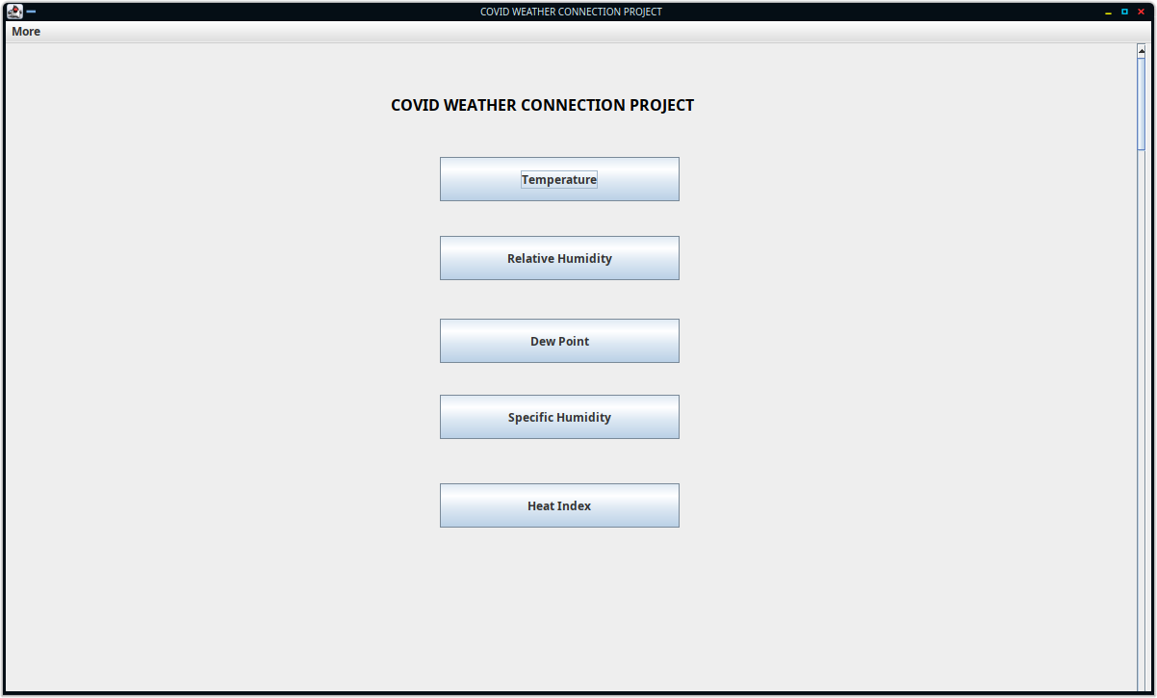
OUTPUTS
Main Page

Slide 9
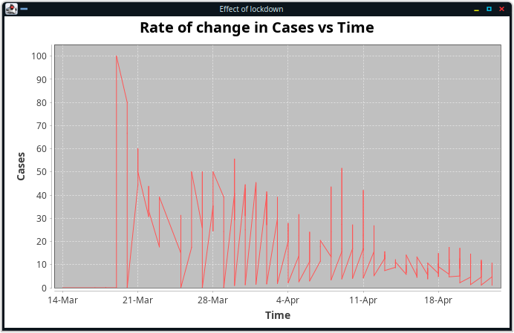
Lockdown Page

Slide 10
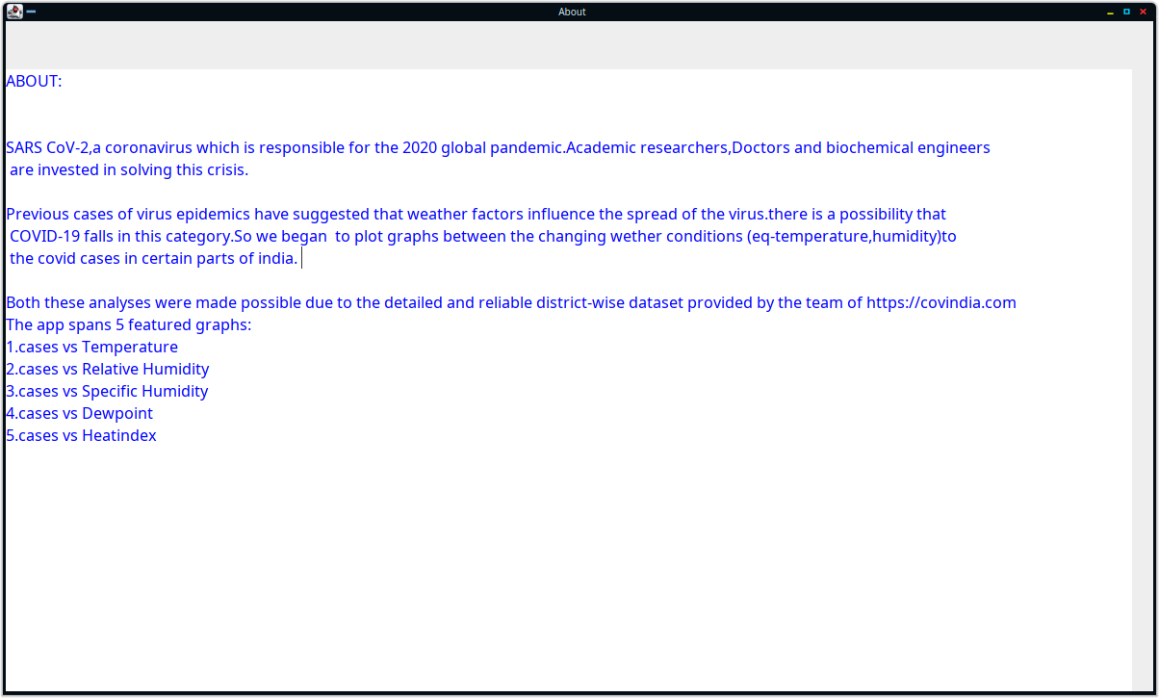
About Page

Slide 11
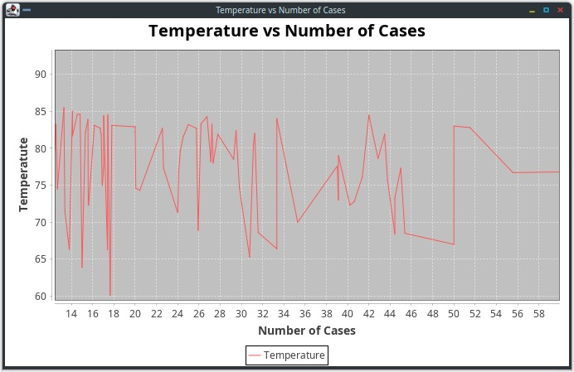
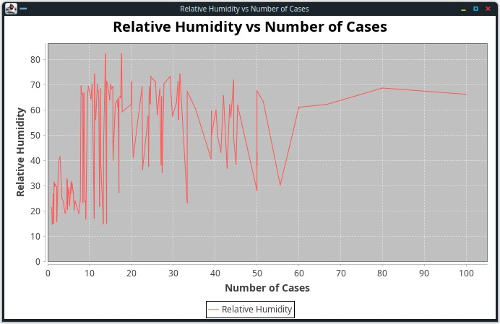
Graphs

Slide 12
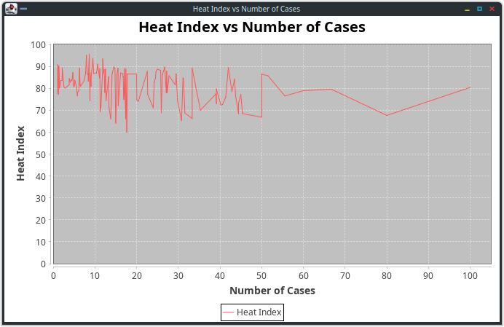
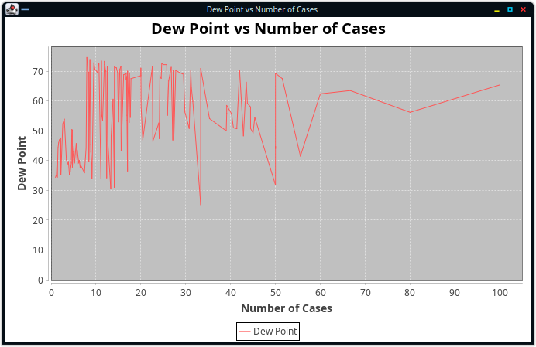
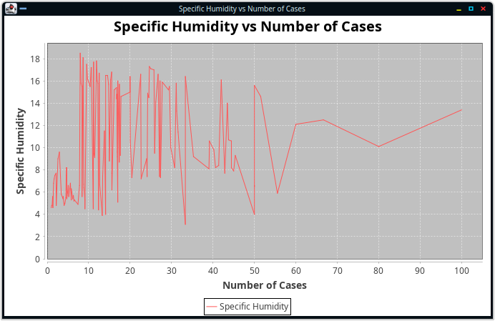

Slide 13
CONCLUSION
The app is successful in graphing all the essential weather factors that have a possibility to play a role in the transmission of the virus. These graphs can further be analysed and studied to draw out significant conclusions on the correlation between the two.
Limitations - Due to the lockdown, some external weather factors like windchill and wet bulb are rendered useless in India. Hence, graphing them has no point since they have a minimal effect in local areas.

Slide 14
Extension of work & Future goals
We could further improve this app to help researchers by exploring other parameters like population density, air quality and pollution levels etc.
Additionally, we aim to add filters and modify the data to trim the noise in order to get more meaningful results.
We're also looking to get better visualizations using additional libraries and tools.
Further, making the UI more user friendly and interactive is also on our agenda for this project.
Furthe

